Slide 1
iCode Guru
Share, Learn & Grow
Join us at www.icode.guru

Slide 2



Our Mission
Join us at www.icode.guru
Employability
Hi-Tech Skills
International Mentors
Notes:
Reduce wording.
Add join us at www.icode.guru under every slide.

Slide 3


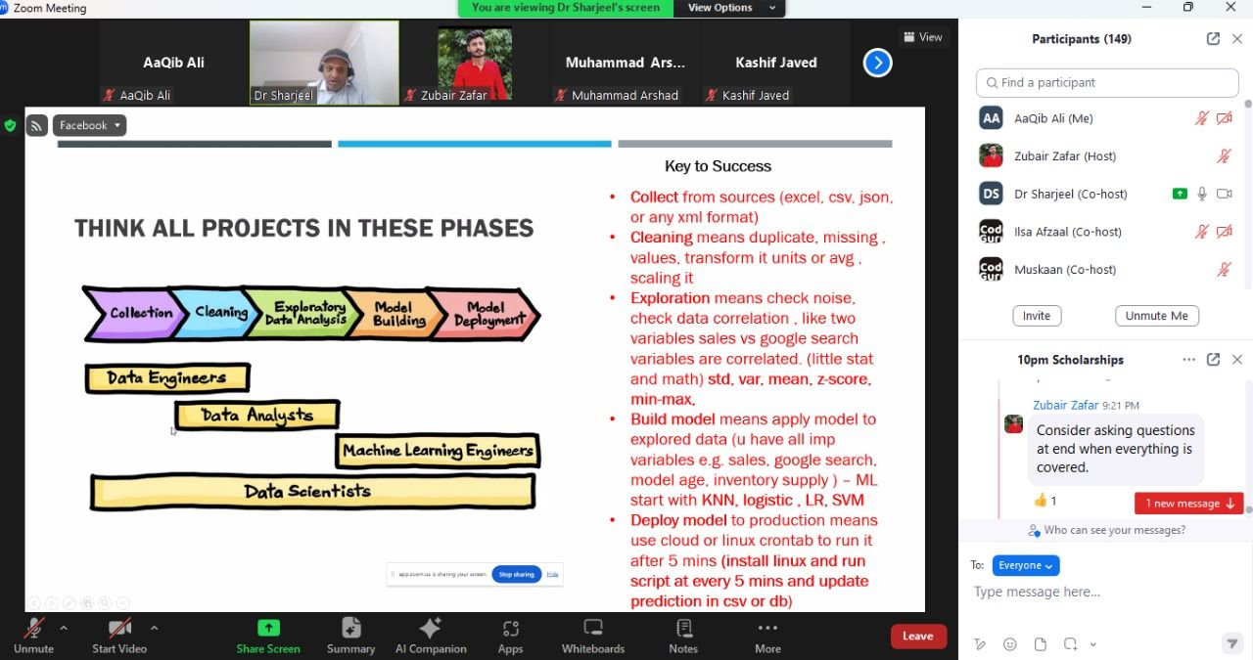






Our Focus/How we Work
Join us at www.icode.guru
15 sessions per day, 1 weekly webinar, 2 weekly workshops
Python for Absolute Beginners
FREE IELTS & GRE Courses
All Sessions are Available on our Facebook page
DSA/leetcode/Interview problems
Machine Learning/Data Science
Notes:
Our Focus:
6 sessions per day, 1 weekly webinar, 1 weekly workshop.
Graduate studies in USa (FREE IELTS and GRE Courses)
Programming (Python/Java)
Web Development (Data Structures)
All sessions are recorded and can be found on Facebook page of iCodeGuru.

Slide 4


Recent Achievements
700+ International Awards in Hackathons/Competitions.
Fully funded graduate admissions around the World including USA.
Local and International Internships & jobs.
Our 38 Teams solved 9/9 puzzles in CS50 Puzzle day by Harvard University 2024
72 Mentors selected at Code in Place Stanford University 2024
3 iCoders were among 320 global selections for the MIT Emerging Talent Program
301 Students from iCodeGuru participated in Google Code Jam 2023
3 interns went to Etihad Aviation Group, World Headquarters Abu Dhabi
Join us at www.icode.guru
Notes:
Facebook XR.
IDAO Olympiad.
Participated in:
Ripe.ai
IDAO Machine Learning Boot Camp.
#BuildwithAI
9 International Awards
1 International Jobs in Hong Kong Based IT Company.
One of the students of iCodeGuru was hired by an IT company through the hackathon competition.
1 Regional Ambassador for future Hackathons.
Increased number of participants from iCodeGuru representing Pakistan on International level.

Slide 5
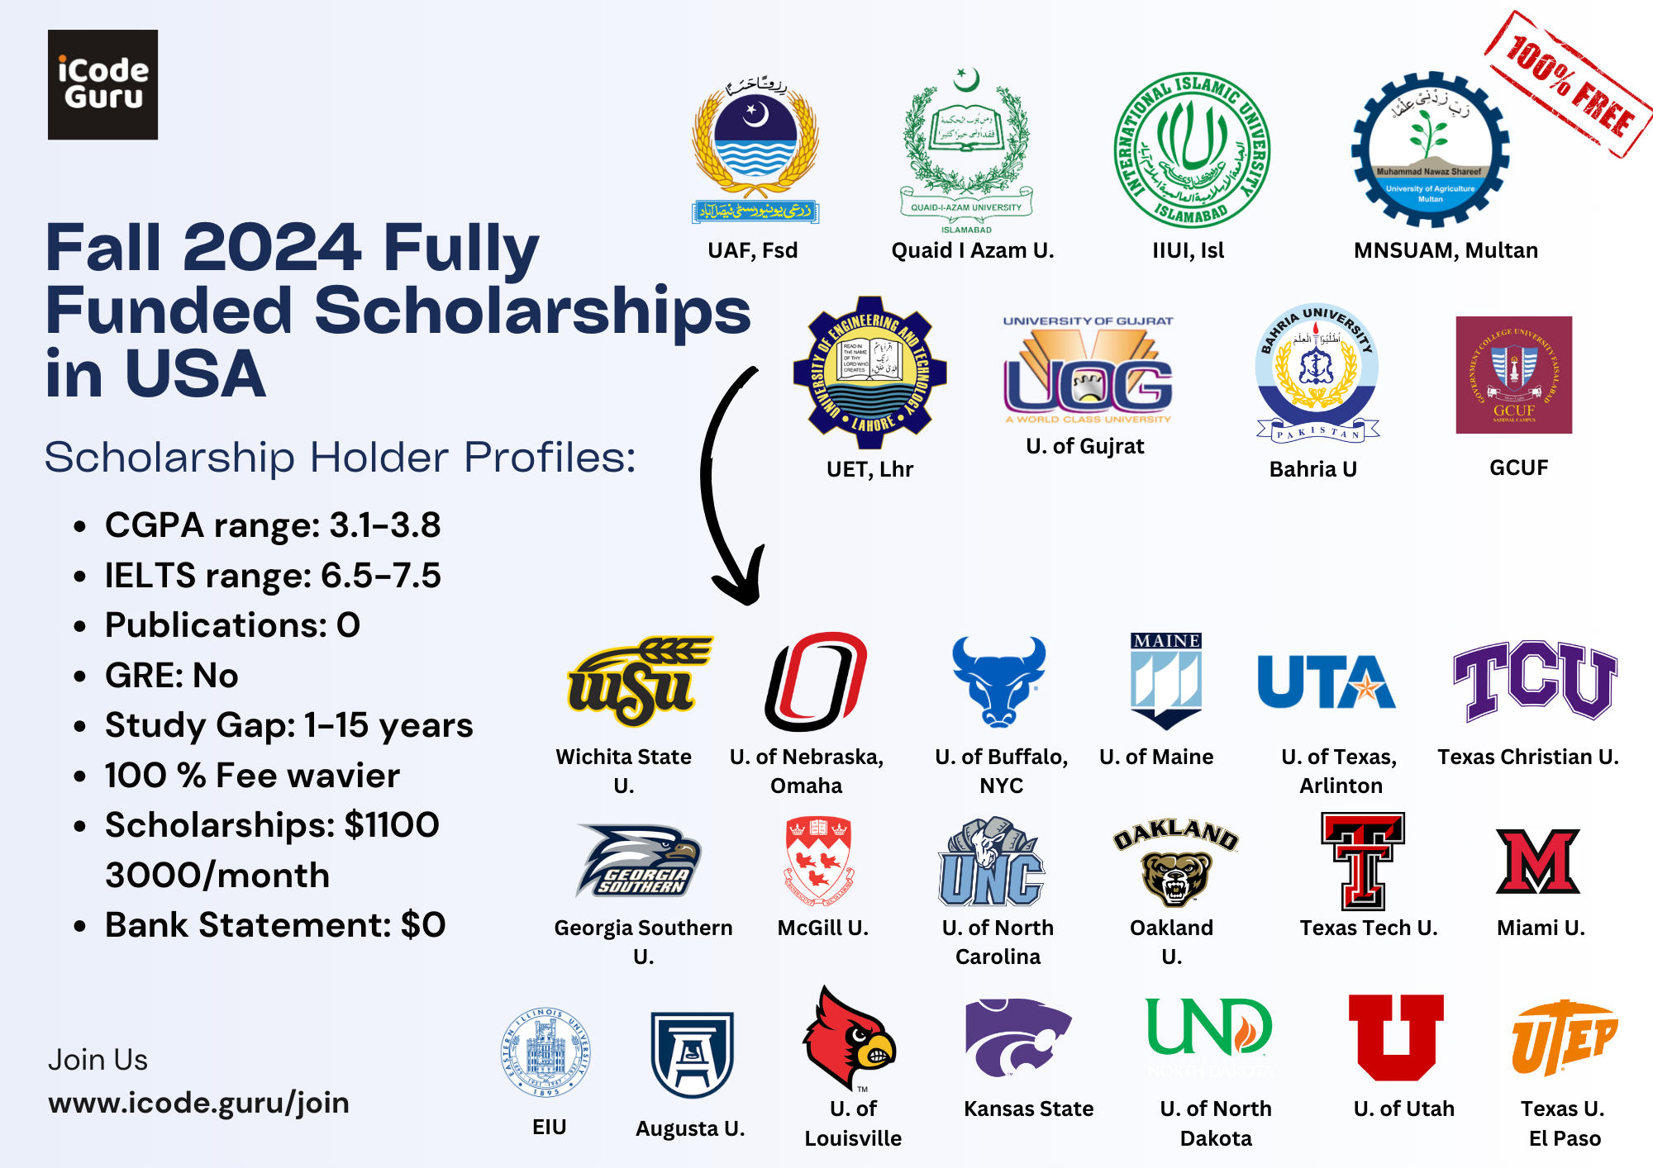

Slide 6
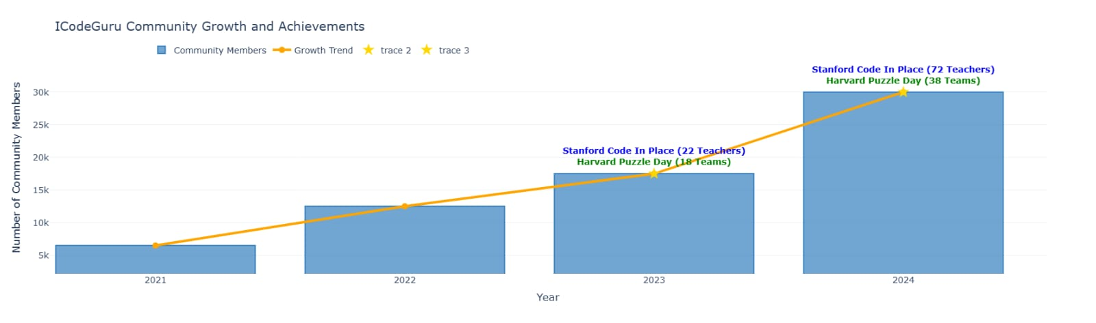

Slide 7
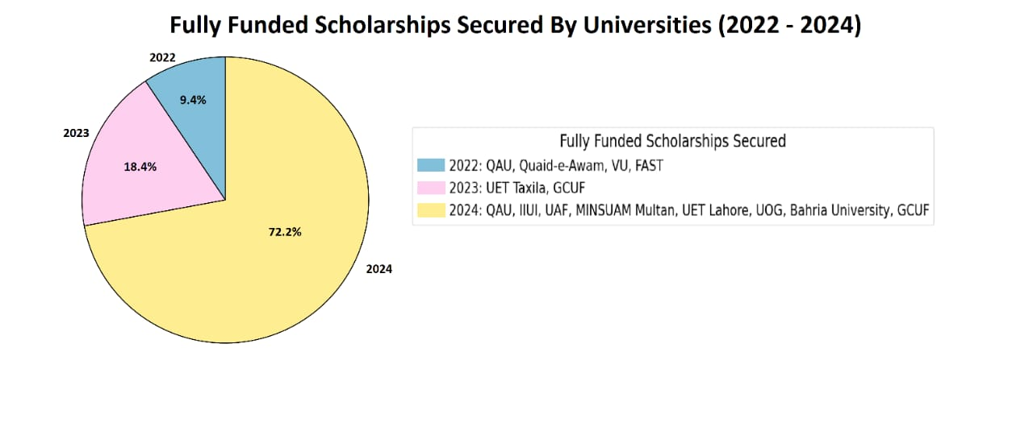

Slide 8
KPIs
Quarterly meetings
KPIs
Number of webinars for international opportunities - 2 per semester
Participation in international Hackathons - 1 per semester
Participation in Coding competitions - 1 per year
Number of Students appearing in IELTs/ score - Per semester
Number of Students appearing in GRE/ score - Per semester
Number of students getting international scholarships - semi-annual

Slide 9
Current Opportunities
WordSprint Developers Hackathon 6.0
𝐁𝐞𝐧𝐞𝐟𝐢𝐭𝐬:
Networking & Teamwork
Exposure to Advanced Technologies
Problem-Solving Skills
Building Portfolio
Certificates for all participants
Deadline: 30th Dec 2024

Slide 10


Thank You
www.icode.guru/join
facebook.com/iCodeGuru

Slide 11
Title: Your Future, Your Terms: The Roadmap to Winning Stanford Scholarships
Guest Speaker:
Ahmed Mohsin (PhD Student @Stanford University, USA)

Slide 12

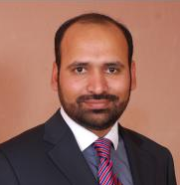


Dr. Zafar Shahid (Engineering Executive, Silicon Valley, USA)
MS/PhD from University of Montpellier, France
Highest Cited Researcher in his domain (Over 40 Publications) & 3 Patients (Books)
Gives Research Funding to for Top Research Lab in USA/Europe
Training Silicon Valley Engineers since 2015 for FAANG
Interviewed over 1000 Candidates at FAANG
Join us at www.icode.guru
@zafarshahid

